Slide 1
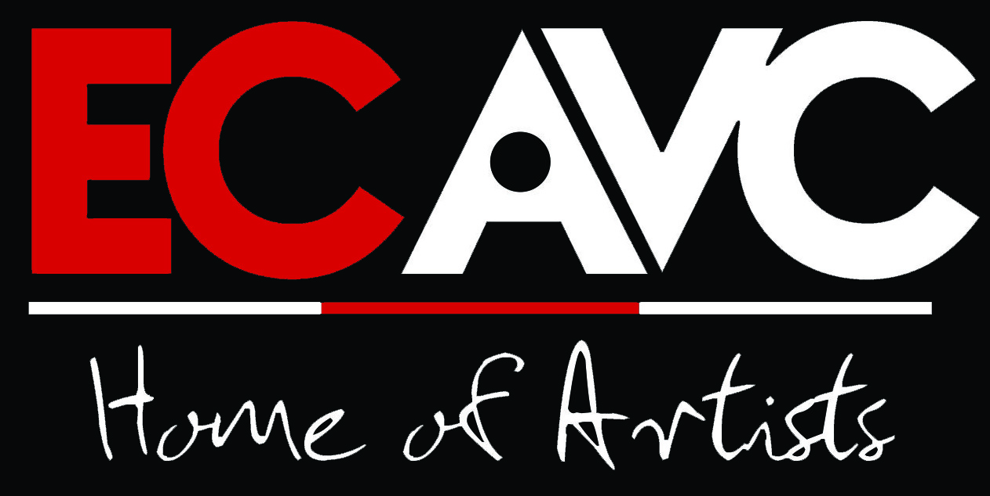
Arts, Youth and Local Economic Development

Slide 2
The role of the creative industries in local economic development

Slide 3
Millennium Development Goals

Slide 4
Vision 2030 – The NDP
Aims to:
Provide financial & ICT support to artists.
Incentivise commercial distribution networks to distribute and/or host art.
Develop and implement plans of arts & culture curriculums in schools with appropriate educator support.
To support income smoothing special unemployment insurance scheme and evaluate funding models for such initiatives.
Develop sectoral determination legislation frameworks to protect art sector employees.

Slide 5
The stats speak for themselves:
GDP:
2003 Norway 3.2%; 3% in Great Britain & 2.3% in the Czech Republic (European Affairs, Unicamp and the UK/India Business Council)
Employment:
Indian cinematographic industry 4m people employed & $2.3b

Slide 6
More stats…
In Latin America, the copyright industries contributed 2% to the GDP of Chile and 2.7% to its national employment between 1990 and 1983.
In Brazil, the cultural industries represented 6.7% of GDP and 5% of employment in 1986.

Slide 7
Now let us look at SA…
The DTI estimated in 2013 that SA's creative sector alone contributed about R2-billion or 0.14% to South Africa's GDP annually.
In addition, the sector provides jobs and income for approximately 38 000 people through an estimated 7 000 small enterprises.
MORE CAN STILL BE DONE!!

Slide 8
The creative sector can also be used as a catalyst for rural economic development and for fostering expanded participation in the economy, especially by women and youth.
Furthermore, as the art of designing and producing cultural products is handed down from generation to generation, members of communities have an opportunity to work together and impart knowledge and social values to each other, especially the youth.
This contributes towards social cohesion and instils the culture of respect, discipline and Ubuntu.

Slide 9
It is for these reasons that we continue to say that cultural heritage represent both an economic activity and a cultural practice.
Moreover tourists are often attracted to a particular area because of its cultural and heritage significance.
While all this presents a very positive scenario for the creative industries in SA, we do face a very serious development problem.

Slide 10
The legacy of apartheid still haunts many such individuals today.
So how do we then ensure that in the post apartheid South Africa Black youth and women involved the creative sectors acquire the necessary skills which would make them perform with distinction and sustain themselves successfully?
Or how do we create the best possible enabling environment for business activity and sustenance for youth and secure their involvement in more established national processes and organizations.?
What kind of skills do we introduce?

Slide 11
According to the Global Entrepreneurship Monitor (GEM), when it comes to entrepreneurial activity, South Africa performs poorly in comparison to other emerging economies.
While the South African government remains committed to supporting small enterprises as one of the drivers of levels of economic growth needed to make an impact on poverty and unemployment in the country, it is unable to successfully support such initiatives.

Slide 12
There have been many efforts aimed at poverty reduction or alleviation since the dawn of the new era in 1994.
social grants
acquisition of certain skills especially technical skills.
Policies around equity have been introduced to ensure that redress does take place and that the once marginalized communities are at par with the rest in our society.
Acts have been passed to make sure that those disadvantaged by apartheid benefit from what the economy offers.

Slide 13
So the question remains: what kind of skills are needed to empower South Africa’s youths, skills that would ensure full sustainability?
The skills that need to be acquired are the ones that could enable youth to gain access to economic opportunities presented by the country’s developing economy.
Normally we would classify many disadvantaged creative practitioners as belonging to the “second economy” as defined by former State President Thabo Mbeki. However for them to be part of the first economy, a formal type of economy, they would then have to acquire certain skills which would enable them to access such opportunities.
In that way they would be active participants in this growing economy.

Slide 14
About Alfred Nzo…
The Alfred Nzo district is the poorest in the Eastern Cape and is characterised by unemployment and a lack of employment opportunities; low income levels; low education levels (55% are considered illiterate); low business growth with poor markets for local products; and problems in accessing finance by small businesses.
The economy is unfortunately declining, in part because the lack of infrastructure deters potential investors. The main contributors to the district GDP are the public sector (education, health and public services) at 68% and agriculture and forestry at 11%. Many households are dependent on state pensions.
Has deep cultural roots, greatly talented youth and elders that still own the gems of the regions’ history. These resources need to be tapped into!

Slide 15
About the ECAVC…
The Eastern Cape Audio Visual Centre (ECAVC) is a joint project of the University of Fort Hare and the Eastern Cape Department of Sport, Recreation, Arts and Culture.
The main focus of the centre is to develop and empower Eastern Cape artists in the areas of AUDIO and VISUAL. Through the Provincial Record Label, ECAVC will identify the talent, record, produce, distribute, publish, market and promote Eastern Cape music across all genres.

Slide 16
ECAVC has three mandates, namely: public, commercial and educational.
Public mandate: ECAVC runs initiatives such as the Eastern Cape Music Showcase and Eastern Cape Music Talent Search which provides opportunities to identify talent, groom, develop and assist to produce high quality recordings that can economically be exploited to benefit the artists. The public mandate ensures that talented artists from the Eastern Cape are assisted to record their music even if they do not have money.
Commercial mandate: artists can book the ECAVC state-of-the-art recording studios and acoustically- treated hall for an affordable fee of only R250 per hour or R2000 per day. The commercial mandate is essential for the centre’s sustainability.
Educational mandate: ECAVC conducts music business workshops throughout the Eastern Cape Province free of charge. ECAVC also presents the music business education show on Link FM every week. The educational mandate provides skills development, training and the impartation of knowledge.

Slide 17
Our key programmes…
Eastern Cape Music Showcase
Providing platform to EC artists to showcase their talent. Reward: single recording; online release; music video; perform at NAF & ECMN; attend Moshito Music Conference
2. Eastern Cape Music Talent Search
Talent identification. Reward: album recording
3. Eastern Cape Music Nights
Job creation
4. Workshops
Skills development & knowledge impartation. Know Your Music Industry on LINK FM.
5. Training & Mentorship Program
To train, mentor and give work experience to young graduates
6. Packaging, Distribution, Marketing & Promotion of EC music
Identifying talent, signing and releasing it through ECAVC Records
7. Preservation of EC Culture & Heritage

