Slide 1
Department of Rural Dev & Agrarian Reform ALFRED NZO DISTRICT MUNICIPALITY
PRESENTED BY J.M MDEBUAKA (DEPUTY DIRECTOR MATATIELE)
2016
1

Slide 2
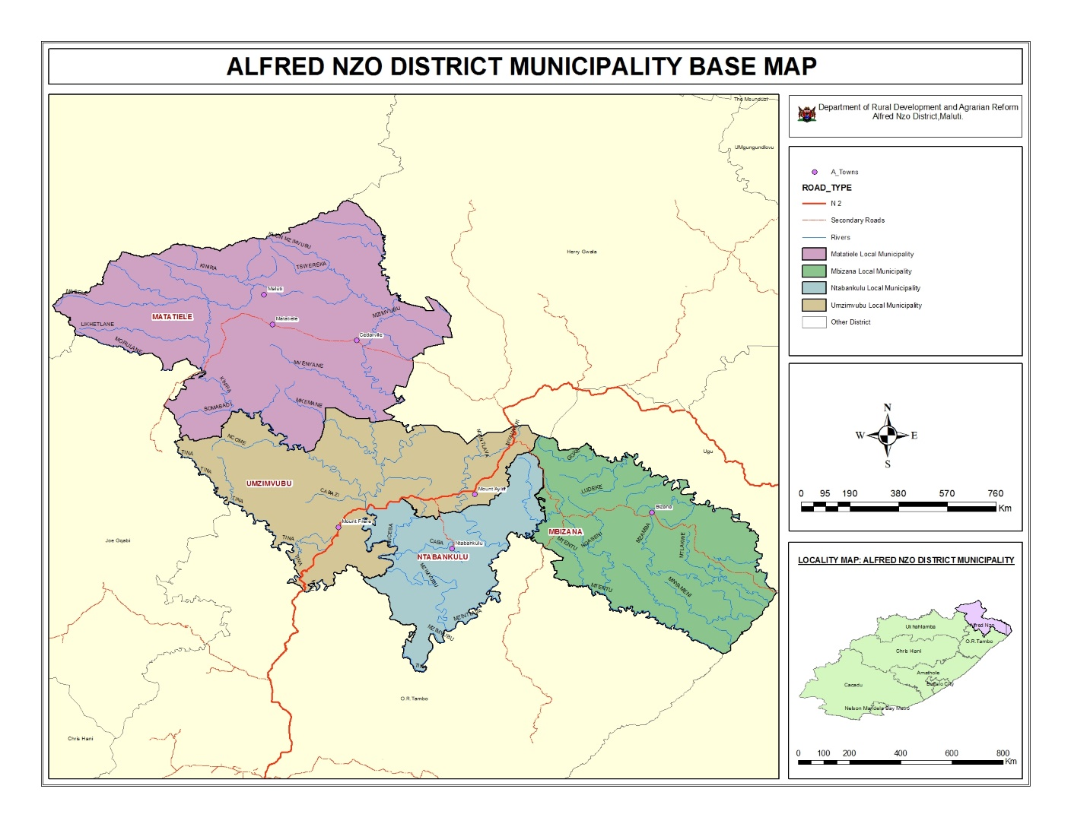
ALFRED NZO MAP

Slide 3
INTRODUCTION
What is drought? Catastrophy Abnormality
Affected municipalities

Slide 4
LIVESTOCK CENSUS
Local Municipality | Cattle | Sheep | Goats | Donkeys | Mules | Horses
Matatiele LM | 60229 | 88803 | 7611 | 430 | - | 1240
Umzimvubu LM | 66205 | 129738 | 8631 | - | - | 1 145
Bizana LM | 44339 | 46423 | 8326 | 437 | - | 1473
Ntabankulu LM | 46203 | 45263 | 18233 | 339 | 116 | 920
Totals | 216976 | 310227 | 42801 | 1206 | 116 | 2903

Slide 5
IMPACT OF DROUGHT ON LIVESTOCK
Local Municipality | Cattle | Sheep | Goats
Ntabankulu | 481 | 1 695 | 1 785
Matatiele | 145 | - | -
Umzimvubu | 897 | 884 | -

Slide 6
INTERVENTION BY DRDAR
100 tons of Lucerne bales received
50 tons delivered to Matatiele
20 tons delivered to Ntabankulu
30 tons delivered to Umzimvubu
50 jojo tanks at (5000 litres ) delivered to Ntabankulu

Slide 7
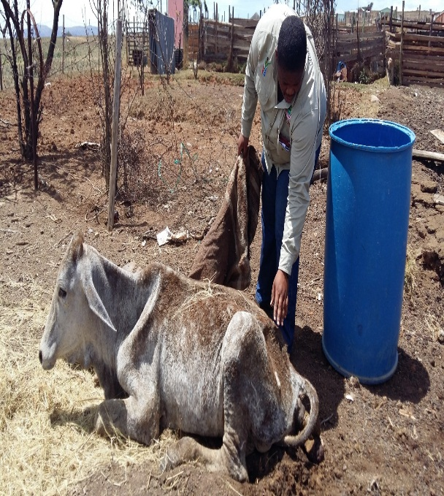
PICTURES OF AFFECTED ANIMALS

Slide 8
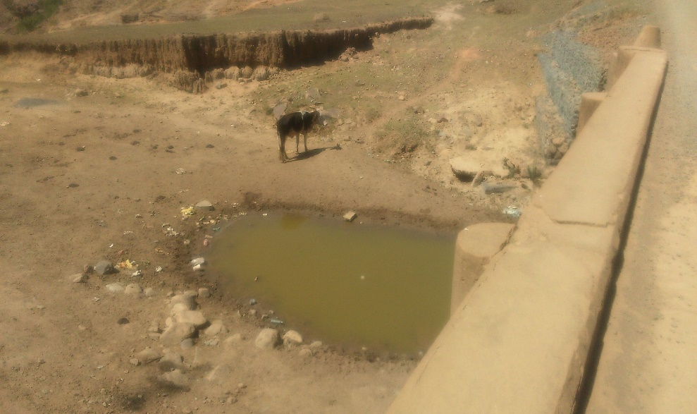

Slide 9
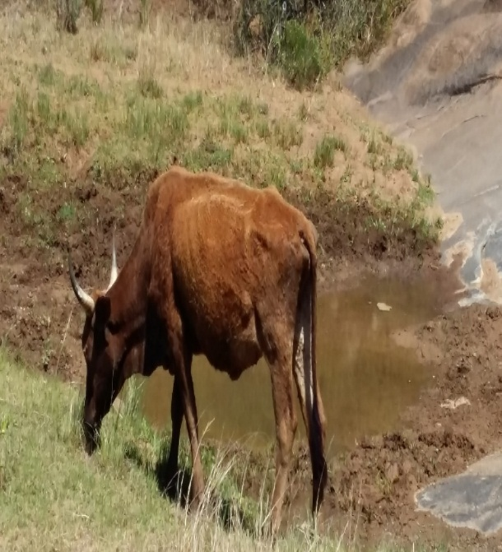
PICTURES CONTI……

Slide 10
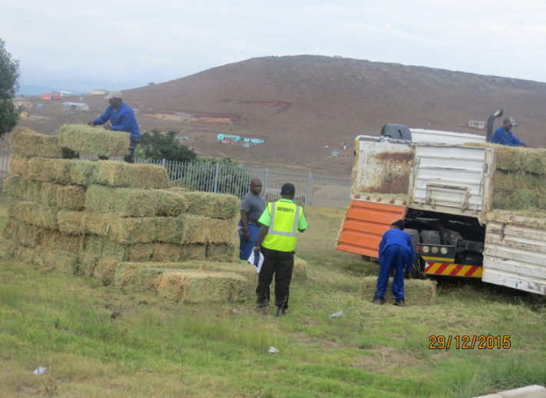
PICTURES CONTI…..

Slide 11
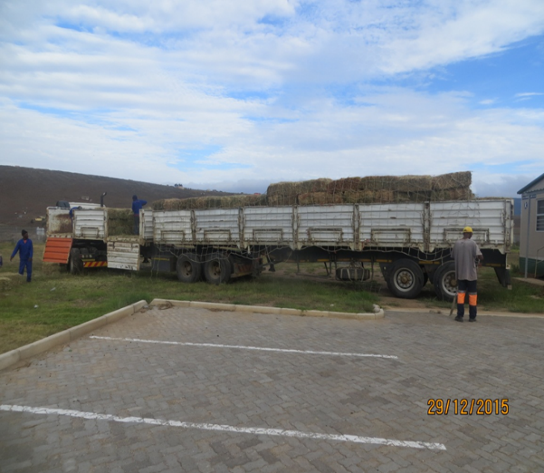

Slide 12
EFFECTS OF DROUGHT ON CROP
Local Municipality | Target hectares | Planted hectares
Matatiele | 2409 | 890
Ntabankulu | 2267 | 1200
Umzimvubu | 2267 | 1077
Mbizana | 2657 | 2657
Local Municipality | Target hectares | Planted hectares
Matatiele | 2409 | 890
Ntabankulu | 2267 | 1200
Umzimvubu | 2267 | 1077

Slide 13
ECONOMIC DROUGHT IMPACT ON LIVESTOCK CURRENTLY
Current price per cattle – +/- R5000-00 per beast
Current price per sheep - +/-R1200-00 per sheep
Future prices per beast and sheep unknown!!!!!!!!!!!!!!!

Slide 14
ECONOMIC DROUGHT IMPACT ON MAIZE
Current price per bag = R140-00
Current price per ton = R2800-00
Future prices per bag and ton is unknown!!!!!!!!!

Slide 15
FUTURE PROSPECTS
Agricultural Red Hub – Mbizana local
Agric Parks – Matatiele
Fodder banks
Boreholes drilling

Slide 16
THANK YOU NDIYABULELA KE EA LEBOHA

