Slide 1
14 January 2016
ALFRED NZO DEVELOPMENT AGENCY-
“ROAD TO BE TRAVELLED TOWARDS CLEAN ADMINISTRATION”

Slide 2
Our reputation promise/mission
The Auditor-General of South Africa has a constitutional mandate and, as the Supreme Audit Institution (SAI) of South Africa, exists to strengthen our country’s democracy by enabling oversight, accountability and governance in the public sector through auditing, thereby building public confidence.

Slide 3
As the Supreme Audit Institution of South Africa we are
committed to professionalisation
9 Provincial Office and
Head Office in Tshwane
29 Chartered Certified Accountants
Offices in all the Provinces
3000+
42 Masters
61 Certified Information System Auditors
332 Registered Government Auditors
500+
Chartered Accountants(SA)

Slide 4
Roles and Responsibilities
Constitution
Section 41(1)(c) - all spheres of government must provide effective, transparent, accountable and coherent government for the country as a whole
Section 188(1) - The Auditor-General must audit and report on the accounts, financial statements and financial management of—
(a) all national and provincial state departments and administrations;
(c) any institution or accounting entity required by legislation to be audited by the Auditor-General.
AGSA Accountability and reporting
The AGSA is accountable to the National Assembly and has to report on its activities and performance of its functions in terms of section 10 of the PAA.
The main accountability instruments are the AGSA's budget and strategic plan, as well as the annual report, both of which are tabled annually in the National Assembly.
The Standing Committee on the Auditor-General (SCoAG), established in terms of section 10(3) of the PAA, oversees the performance of the AGSA on behalf of the National Assembly.
MFMA Section 126
The Auditor-General must audit the financial statements referred to in subsection (1) (b) and submit an audit report on those statements to the accounting officer within three months of receipt of the statements.
MFMA Section 121(4). Tabling in councils—
(2) The mayor of a municipality must, within nine months after the end of a financial year, table
in the municipal council the annual report of the municipality and of any municipal entity under the
municipality’s sole or shared control.

Slide 5
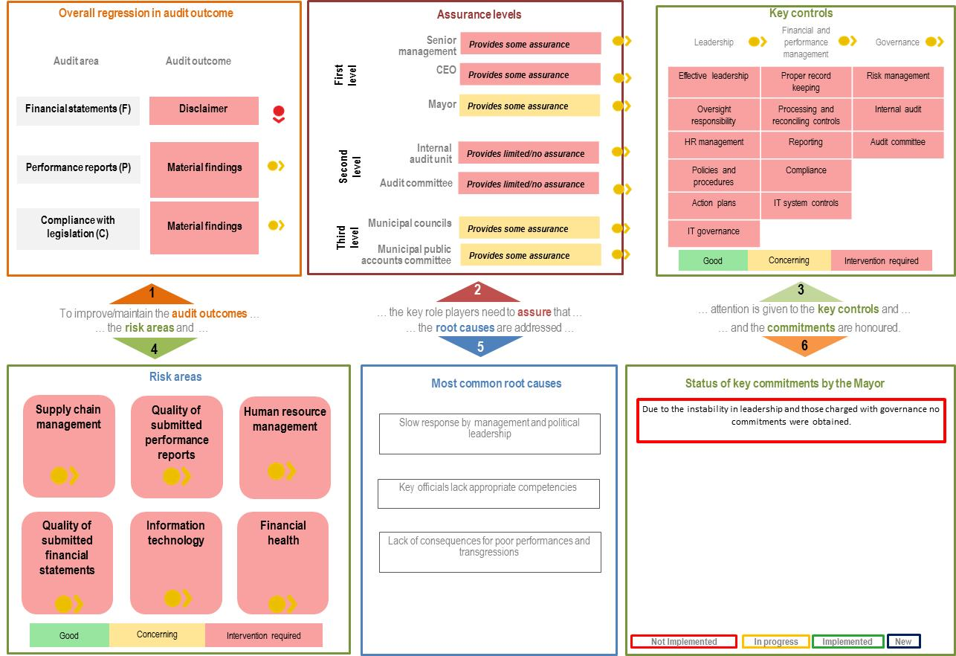
9
Characteristics of clean audits

Slide 6
9
Accounting officers were proactive in driving action plans to improve the financial control environment and to instil a culture of good financial governance and compliance with legislation.
Executive authorities and accounting officers set a tone of zero tolerance for non-performance and held staff accountable.
Robust and proactive audit committees and internal audit units dealt effectively with matters regarding implementing and monitoring action plans to address recurring findings and the commitments made
Accounting officers and senior management successfully implemented basic internal controls and disciplines by preparing regular and accurate financial statements and performance reports
Stability at senior management level and within finance units, with the required level of technical competence and experience.
Characteristics of clean audits

Slide 7
Best Practices
2014-15
MFMA
Unqualified opinion with no findings (clean audit)
Municipal entity:
produced financial statements free of material misstatements
reported in a useful and reliable manner on performance as measured against predetermined development objectives in the corporate plan
complied with key legislation
This is achieved by
Leadership creates an environment which is conducive to internal control and oversight. This is facilitated through stability in leadership.
Senior management ensure controls are in place for robust financial and performance management reporting systems.
There is a focus on governance through risk management activities and effective internal audit units and audit committees.
Leadership
Financial and Performance Management
Governance

Slide 8
Best Practices - Their continued focus on these basic controls contributed to their success
2014-15
MFMA
Effective
leadership culture
Leadership established a culture of ethical behaviour, commitment and good governance;
Human resource controls
Good HR practices - ensure adequate and sufficiently skilled official are in place and their performance is managed;
ICT governance and controls
Attention to ICT to ensure it supports objectives and processes and maintain confidentiality, integrity and availability of information;
Audit action plans
Audit action plans used to address internal control weaknesses
Proper record keeping
Proper record keeping to ensure information is accessible and available to support financial and performance reporting;
Daily and monthly controls
Basic disciplines and controls are in place for daily and monthly processing and reconciling of transactions;
Review and monitor compliance
Mechanisms in place to identify applicable legislation and changes and processes to ensure and monitor compliance with legislation.

Slide 9
Municipal entity business processes
Constitution 152 – objectives of local government:
provide democratic and accountable government for local communities;
to ensure the provision of services to communities in a sustainable manner;
to promote social and economic development
to promote a safe and healthy environment; and
to encourage the involvement of communities and community organizations in the matters of local government.
Planning and budgeting
Procurement
Project Implementation & monitoring
Reporting & oversight
Objectives of the “Back to Basics” approach:
Effective public participation platforms.
Delivering municipal services at the right quality and standard. This includes planning for and delivery of infrastructure and amenities, maintenance and upkeep, including the budgeting to do this.
No failures in services
Good governance and administration - cut wastage, spend public funds prudently, hire competent staff, ensure transparency and accountability.
Sound financial management and accounting, and prudently manage resources so as to sustainably deliver services and bring development to communities.
Build and maintain sound institutional and administrative capabilities managed by dedicated and skilled personnel at all levels.

Slide 10
Planning: Usefulness of performance objectives
MTSF - Planning will be institutionalised in government and there will be an enhanced focus on programme implementation, problem-solving, and continuous improvement. Innovative approaches will be adopted where progress needs to be made to overcome obstacles and achieve better results.
Usefulness refers to setting objectives, indicators and targets in the planning documents (annual performance/corporate plan), and how they are reported on in the annual performance report. We measured the usefulness of the reported information against the criteria of presentation, consistency, relevance and measurability.
Reliability refers to whether information presented in the annual performance report is reliable. We measured the reliability of the reported information against the criteria of accuracy, completeness and validity
4.6. Evaluation of misstatements at a development priority/objective level
The following decision rules can be applied, but cannot substitute the exercise of proper professional judgement in the specific circumstances of the audit client and the tests being performed: ** If the average of the aggregated misstatement occurrence rate < 20%, then the misstatement is not material. ** If the average of the aggregated misstatement occurrence rate >= 20%, then the misstatement is material. ** If the average of the aggregated misstatement occurrence rate >= 50%, then the misstatement is material and pervasive.

Slide 11
Procurement
Constitution Section 195 - Public administration must be governed by the democratic values and principles enshrined in the Constitution, including the following principles:
(b) Efficient, economic and effective use of resources must be promoted.
(d) Services must be provided impartially, fairly, equitably and without bias.
MTSF - Promoting BBBEE and local procurement are key objectives of the major revamp of government’s procurement systems which is now under way, in addition to obtaining better value for money and reducing corruption.
Irregular Expenditure (SCM = 100%)
Root Causes
Movement | R'000
Opening Balance | 9 083 588
Incurred during year | 652 903
Closing Balance | 9 736 491
Lack of consequences for transgressions (Culture of tolerance)
Lack of monitoring and oversight of compliance with SCM regulations
Poor record keeping of or, inadequate, source documents
MTSF - Corruption is partly a symptom of a wider problem relating to weak management and operations systems, which create the space for corruption to occur. The improvement of operational management, and especially procurement systems, will therefore play an important role in reducing the scope for corruption.

Slide 12
Reporting – Quality of Financial Statements and performance reports
MFMA - Section 95 – Accounting officer must ensure that full and proper records are kept of the financial affairs of the entity.
Adequate leadership oversight
Stable control environment
Involvement of IA/AC
Credible Interim reporting
Good performance and consequence management

Slide 13
Top 4 qualifications – root causes – Mainly skills (HR)
Irregular expenditure
System in place to track and report on irregular expenditure is deficient
PPE
Asset accounting processes inadequate
General and project expenditure
Accounting for transactions inclusive of VAT
Payables
Not accounting of payables on monthly basis
Lack of understanding of what constitutes irregular expenditure
Lack of understanding of SCM processes by officials
No creditor reconciliations
No raising of accruals
Inadequate filing system
Root causes
Poor planning, lack of skills, lack of effective oversight due to information not being credible, lack of consequence management, not implementing audit recommendations

Slide 14
Way forward………………………………
Leadership and those charged with governance must drive these actions and ensure accountability and transparency in all processes
Regulate and reform the general control environment
Draft credible audit intervention plan to be monitored by internal audit, audit committee and leadership
Respond to prior period findings
Credible Interim reporting (Monthly)
Good performance and consequence management
Implement all oversight bodies recommendations swiftly

