Slide 1


Slide 2

ALFRED NZO DISTRICT MUNICIPALITY
LOCAL ECONOMIC DEVELOPMENT STRATEGY

Slide 3
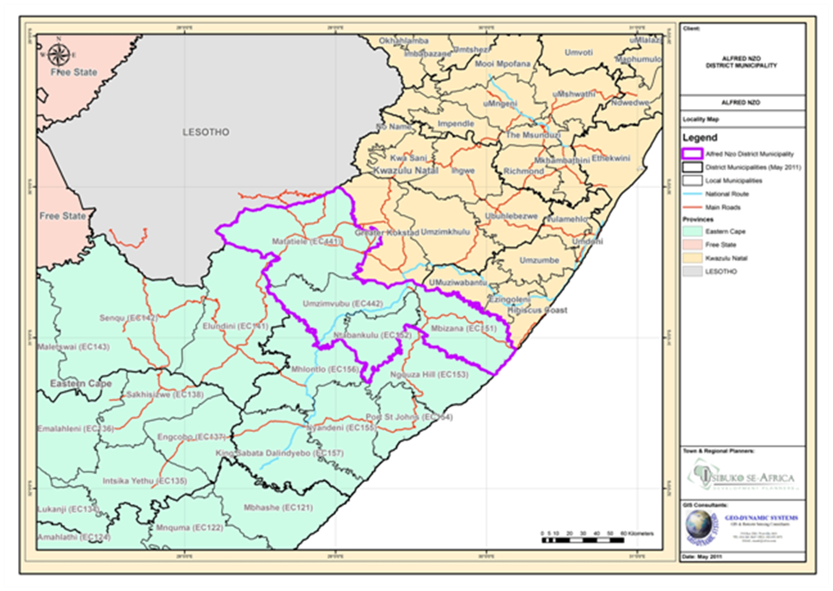
ALFRED NZO DISTRICT MUNICIPALITY
Northeastern part of Eastern Cape Province
Local municipalities: Matatiele, Umzimvubu, Ntabankulu and Mbizana
1 of 6 district municipalities
strategic & unique location
  stretches from Drakensberg Mountains where it borders with Lesotho down to coast in the east.
Area: 11119m²
Population -900 492

Slide 4
PLANNING PROCESS
Phase 1: Project
Phase 2:
Analysis of the
Phase 3: LED Strategy
Phase 4: LED
Phase
Inception
Local Economy
programme & projects
Time
Month
1
-
2
Month
2
3
To facilitate discussion
To
assess the current
To
develop a strategy that
To develop a
framework
and agreement on the
situation
would build the local
for an effective
Objective
terms of reference,
economy
implementation of the
approach & methodology
strategy
⇒
Initial data
⇒
Contextual
⇒
Competitive
⇒
Institutional
collection
analysis
&comparative
planning
⇒
Identification of
⇒
Socio
-
economic
advantage
⇒
Funding options
information gaps.
analysis
⇒
Economic
⇒
Area marketing
⇒
Stakeholder
⇒
Economic
constraints
framework
Activities
identification and
assessment
&
⇒
Economic
⇒
Implementation
analysis.
issues
development
program
⇒
Project Inception
⇒
Local economy
opportunities
⇒
Monitoring &
Report.
⇒
Projects inventory
⇒
Action framework
evaluation
⇒
First PSC meeting.
⇒
Sector
analysis
⇒
Resource
framework
⇒
Signing Contract.
mobilization
strategy
Meetings & Report
Stakeholder
Stakeholder
Stakeholder meetings,
Inputs
preparation
consultation
consultation
Technical assessments
Desk
-
top data review
Desk
-
top data review
Research etc
Research etc
PROJECT INCEPTION
STATUS QUO REPORT
STRATEGY
REPORT
LED STRATEGY/PLAN
Results
REPORT
IMPLEMENTATION
FRAMEWORK

Slide 5
LED MANDATE
Mandate in terms of Constitution of the Republic of SA
  to promote social and economic development
White Paper on Local Government - ‘developmental local government’
  identifies local economic development -key performance areas mandate is executed, among others, in terms of the Local Government: Municipal Systems Act, 2000 (Act No. 32 of 2000)
ANDM IDP
  identifies, inter alia, LED as key performance area
  & strategic intervention for promoting socio-economic development, alleviating poverty and improving the quality of life

Slide 6
POLICY FRAMEWORK
National
New Growth Path
Provincial
EC Growth & Development Plan
Local
ANDM District Growth and Development Summit
National Development Plan
Industry Policy Action Plan
National Tourism Sector Strategy
Comprehensive Rural Development Programme
2006 National Framework for Local Economic Development
Provincial Spatial Development Plan
Eastern Cape Rural Development Strategy
EC Provincial Industrial Development Strategy
ANDM IDP, SDF, ABP
Matatiele IDP, SDF, LED
Umzimvubu IDP, LED, SDF
Mbizana IDP, LED, SED
Ntabankulu IDP, LED, SDF
Government frameworks –guide economic development targets for the country.
ANDM LED Strategy - take cognizance of these & their implications for local economic development

Slide 7
POPULATION DYNAMICS
Demographics: Population
Matatiele - higher concentration of economic activities & perceived access to opportunities
Densities – Mbizana – highest densities
Settlement densities in eastern portion of the district –high
  indication of distribution of the population
Settlement densities –indication of LED focus areas
 | ANDM | Ntaban-kulu | Mbizana | Umzim-vubu | Mata-tiele
Population | 910 666 | 146 196 (16%) | 248 879 (27%) | 224 008 (25%) | 255 583 (28%)
Annual population growth (1995-2010) | 1.1 | 0.8 | 1.2 | 0.9 | 1.7
Households |  | 30 499 | 52 205 | 51 069 | 56 408
Average household size |  | 4.8 | 4.7 | 4.4 | 4.5
AREA (KM²) | SIZE | DENSITY
Eastern Cape Province | 169 056 | 40
ANDM | 10 734 | 84.8
Ntabankulu | 1 459 | 100.1
Mbizane | 2 415 | 117.9
Umzimvubu | 2 507 | 89.3
Matatiele | 4 352 | 58.7

Slide 8
POPULATION DYNAMICS
Demographics: Age
 | Mbizana | Ntabankulu | Umzimvubu | Matatiele
Child population | 118 446 | 58 446 | 89 050 | 101 352
Working age population | 152 890 | 79 688 | 122 479 | 140 854
Aged population | 13 543 | 8 061 | 12 479 | 13 377
Age Dependency Ratio | 86 | 83 | 83 | 81
Large youthful population
Small mid-age cohort –shortage in experienced workforce members
Age dependency – highest in Mbizana
Increased dependency ratio in district
  Increases burden on productive part of population to support the economically dependent

Slide 9
POPULATION DYNAMICS
Demographics: Education
Education impact on economy
  Determines type of employment (skills profile)
  Determines employability of the economically active population
  Influences quality of life of residents
  leads to the unavailability of skilled workers
  Workforce drawn into the district from other areas
  affects the ability of the community members to acquire skills and receive further education and training
Generally low levels of education
Primary education +no formal education = high level of functional illiteracy

Slide 10
POPULATION DYNAMICS
Socio-economic:
67.7%-not economically active
Ntabankulu -highest unemployment rate (48.6%)
78.6% of the population earning less than R800 per month
District poverty rate – 66.2%
Generally high poverty rates & low HDI for district

Slide 11
ACCESS TO BASIC INFRASTRUCTURE
District - weak enabling environment
  Refers to availability if service delivery and infrastructure
  critical to attract investment opportunities to the area
Refuse - largest number of households have own refuse dump
Sanitation – majority has pit latrines
Water disparities between urban & rural
  Strong dependence on dams, springs, rivers as water source
Access to electricity remains a challenge
Road network exist
  Regular upgrade & maintenance required

Slide 12
DISTRICT ECONOMY: Regional & provincial
EC contribution to national GDP - 7.8%
ANDM has the second smallest GVA or GDP of districts within province
Largest sector contribution from ANDM - toward agriculture (1%) & services (0.8%)
Agricultural sector –largest employer in district, but ANDM is smallest employer in this sector in province
Spatial distribution of employment in the Eastern Cape, 2008
Area | Total | Agriculture | Manufacturing | Services
Metro | 30.5% | 5.9% | 49.1% | 29.1%
Cacadu | 10.1% | 40.9% | 4.8% | 7.4%
Amathole | 37.0% | 20.4% | 40.9% | 38.2%
Chris Hani | 7.9% | 13.9% | 2.1% | 8.6%
Ukhahlamba | 3.2% | 10.4% | 0.6% | 2.9%
O.R Tambo | 9.6% | 6.4% | 2.5% | 11.8%
Alfred Nzo | 1.7% | 2.3% | 0.1% | 2.0%

Slide 13
DISTRICT ECONOMY: ANDM
Area | GGP contribution | GGP output (Rm) | Average annual growth rate per year (1995-2009)
Ntabankulu | 21.9% | 796.2 | 6.6%
Mbizana | 9.3% | 279.6 | 7.8%
Umzimvubu | 30.7% | 637.9 | 8.1%
Matatiele | 38.1% | 1043.7 | 9.2%
ANDM | 100.0% | 2757.7 | 8.1%
Best performing LM – Matatiele
Gross Value Added per municipality
  Tertiary sector is dominant in each LM
  Primary sector – smallest
Dominant sectors:
  government service sector (36%)
  finance and business services sector (19%)
  trade sector (18%)
Employment per sector:
  government services -33.2%
  Trade – 24%
  Agriculture – 19% (labour intensive sector with low productivity)

Slide 14
AGRICULTURAL SECTOR
Agriculture poses significant development potential
Commercial agriculture- concentrated in Matatiele LM
Subsistence agriculture– dominant in majority of ANDM
Forestry - key sector for support by government
  value chain -forestry feeds downstream processing activities
  effective value chain will have multiplier effect on the AND if successfully exploited
  Large govt. sector involvement in ANDM
  Government should facilitate process of converting some plantations into commercial forestry plantations
Contribution to district economy
  steady growth between the period 1995 and 2010
  But -agricultural sector only contributed 3% to the district economy in 2009

Slide 15
AGRICULTURAL SECTOR
Agricultural activities
Main challenges
Livestock farming
Planted cultivars / crop farming -dominated by maize
Forestry –limited to some areas
Other: honey production, Community level fishing
Cultivated potential for:
  biofuel crops (including sugar, sunflower, canola and soybeans)
  horticultural products
  intensive irrigation-based cropping
  deciduous fruits
  high value herbs and essential oils
Limited support -emerging farmers
Limited access to high potential agricultural land
Unresolved land restitution claims.
Degradation of ecosystems
Lack of enabling farming infrastructure (stock-handling, selling and dipping facilities, modern milking parlours, sales pens).
Skills, capacity and resource constraints in the techno-sphere.
Shortage of storage silos -maize etc
Forestry plantations not commercial

Slide 16
TRADE AND COMMERCIAL SECTOR
A key economic sector
  Contributes 18% to district economy
  Contributes 24% to employment
Sub-sectors
  Community, social and personal services
  Financial intermediation, real estate and business services
  Wholesale and retail trade, etc, hotels and restaurants
Substantial growth between 1995 and 2010 in almost all sub-sectors.
Some sub-sectors (catering & accommodation services, transport, communication & business services) remain relatively small.

Slide 17
TRADE AND COMMERCIAL SECTOR
WHOLESALE AND RETAIL TRADE
FINANCE AND BUSINESS SECTOR
Informal sector
  hawkers on pavement, markets & taxi ranks
  rural parts -spaza shops –daily necessities
Formal sector
  urbanised areas (towns)
  Matatiele, Bizana, Mt Frere, Mt Ayliff, Ntabankulu
  wholesalers, general dealers, semi-specialist stores
Business sector
  relatively small
  demand for professional services (e.g. accounting, legal services etc.) is low
Majority of business services -Matatiele , Mthatha & Kokstad
Financial services (banking services)
  are available in all 4 municipalities

Slide 18
TOURISM
Small and underdeveloped sector
  limited marketing exposure and penetration
  low variety of activities & undersupply of graded facilities
Important economic growth sector
Transit & business tourism, and nature based tourism (eco-related tourism)
Tourism concentrated in Matatiele & Mbizana municipalities
Proposed rerouting of the N2- implications for ANDM
  rerouting will bypass Mt Ayliff and Mt Frere (on existing N2 route)
  New route to run along the coast
  decline in stopover and business tourism

Slide 19
MANUFACTURING
Manufacturing, processing & construction
Contribution to economy
  District - relatively small – 12%
  Provincial – insignificant-0.1%
Steady but noticeable growth between 1995 and 2010
Manufacturing sector’s capacity - concentrated in Matatiele & Umzimvubu
Limited large scale manufacturing activities
Manufacturing activities:
  Food processing activities (e.g. milling, processing of animals products)
  Processing of wood products - very little value adding
  Small-scale artisan products –e.g. brick making, sewing, hand craft and art related articles, welding, panel beating, scrapping of metal, etc.
Challenges:
  Competition & concentration in Kokstad Mthatha
  value adding processes –low
  rural nature of the district

Slide 20
GOVERNMENT
Largest contributor to the economy
  36% to R-GGP
  33% to employment
Access to a range of services and functions
  Provision of essential public services
  Developing skills
  Administration & implementation of poverty alleviation & reduction programs & strategies
  Developing infrastructure and facilities
  Improvement of community livelihoods

Slide 21
MINING
Limited scale
  little commercial exploitable endowments of precious metals & minerals
Mineral deposits are few
  titanium, sand, quarry & high quality clay, limestone, sandstone & shale
Actual performance - below expectations
Major challenge -informality & lack of regulation
Small-scale mining activities
  Sand Mining
  Quarrying- construction purposes
Application for titanium mine at Xolobeni in Mbizana Municipality

Slide 22
CONSTRUCTION
Among smallest economic sectors
  contribute approximately 3% to district economy
Challenge
  basic levels of skills, experience and competence
  Unable to undertake large high value construction projects
Training and capacity building required
Growth
  Increase in building of houses
  Retail infrastructure / expansion by the private sector
  Bulk infrastructure investment and maintenance - government expenditure

Slide 23
INSTITUTIONAL
GOVERNANCE AND ADMINISTRATION
SYSTEMS AND PROCEDURES
LED SUPPORT AGENCIES
GOVERNMENT SUPPORT
Portfolio Committee for LED : sub-committee of council (delegated powers,-drives implementation of LED )
LED forums –requires resuscitation in all LM
District Support Team -regional officials involved in LED interact with private sector
LED capacity: LED function - within Development Planning and Economic Development Directorate of ANDM
Challenges -attraction and retention of staff
By-laws: dealing with range of issues based on allocated powers & functions
Supply chain Management (promote and support local business)
Monitoring and Evaluation: Performance Management System
No tools and systems for monitoring project implementation and evaluating impact
Economic Intelligence: collection & maintenance of economic data can provide important information on district
Alfred Nzo Development Agency
District Municipality SEDA
DEDEAT-focus - agricultural value chain
DRDAR- poverty alleviation
Department of Agriculture and Forestry -emerging farmer support
SEDA, DTI etc.
OTHER: Ithala Bank, Land Bank , Development Bank, ECDC etc.

Slide 24
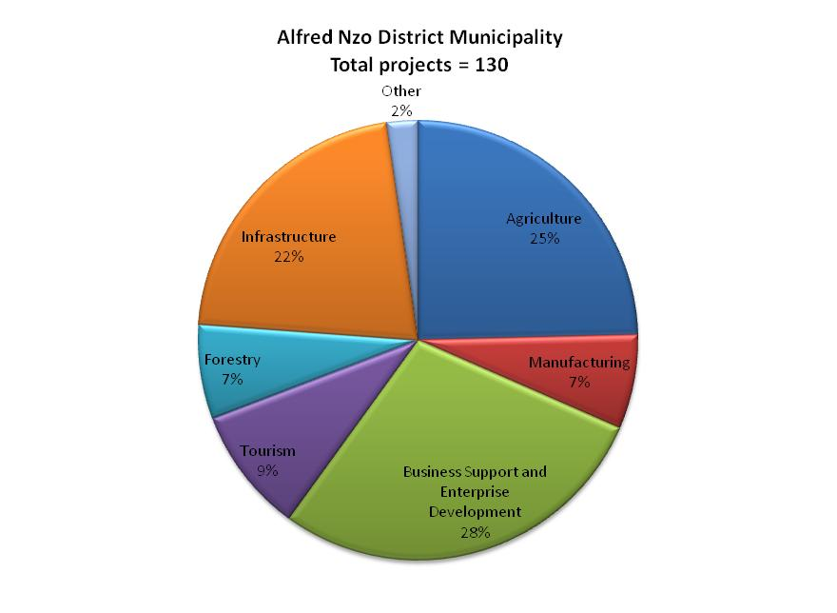
PROJECTS
Sector | Ntaban-kulu | Mbizana | Umzimvubu | Matatiele | ANDM
Agriculture | 6 | 19 | 5 | 3 | 33
Business | 9 | 16 | 7 | 5 | 37
Forestry | 4 | 1 | 2 | 2 | 9
Infrastructure | 9 | 5 | 9 | 5 | 28
Manufacturing | 1 | 3 | 3 | 1 | 8
Tourism | 3 | 3 | 4 | 2 | 12
Other | 2 | 1 |  |  | 0
Grand Total | 34 | 48 | 30 | 18 | 130
Majority of projects concentrated in:
  Business support & enterprise development sector -28%
  Agricultural sector - 25%
  Infrastructure projects -22%
Manufacturing, tourism & forestry – less emphasis

Slide 25
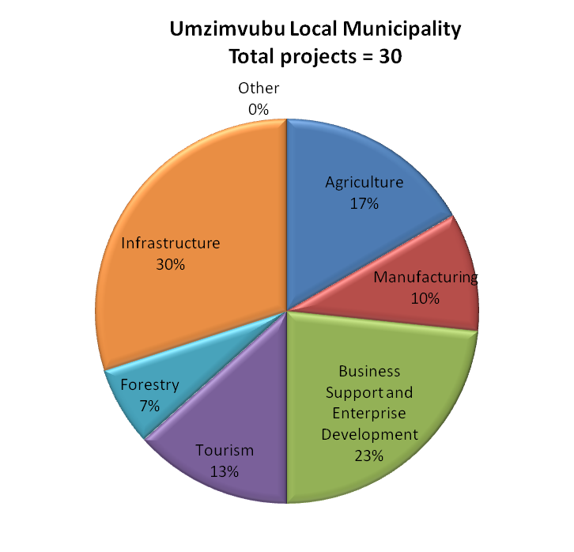
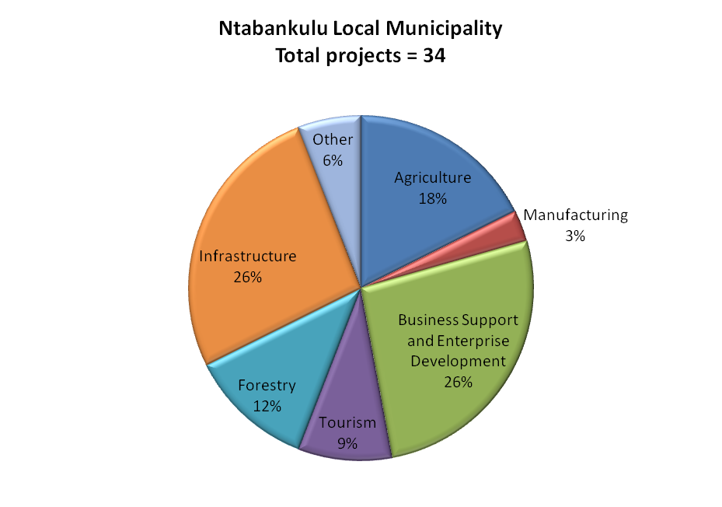
Project distribution per sector and municipality
Both municipalities have strong focus on creating enabling environment & business sector
Umzimvubu -30 LED projects
Infrastructure sector - 30%
Business support -23%
Agricultural sector - 17%
Ntabankulu-34 LED projects listed
Infrastructure & business support sectors -26% each
Agricultural sector - 18%

Slide 26
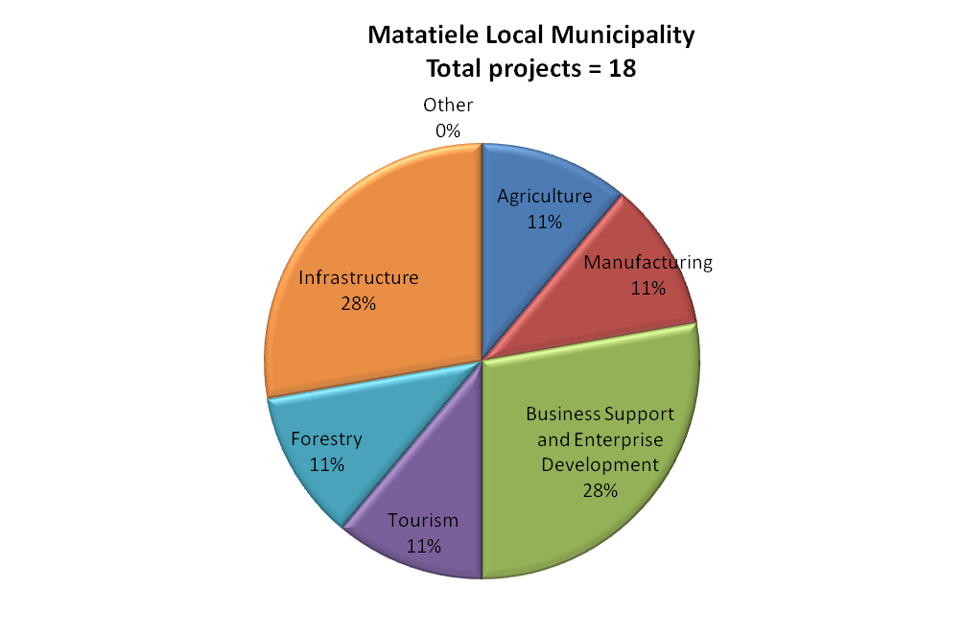
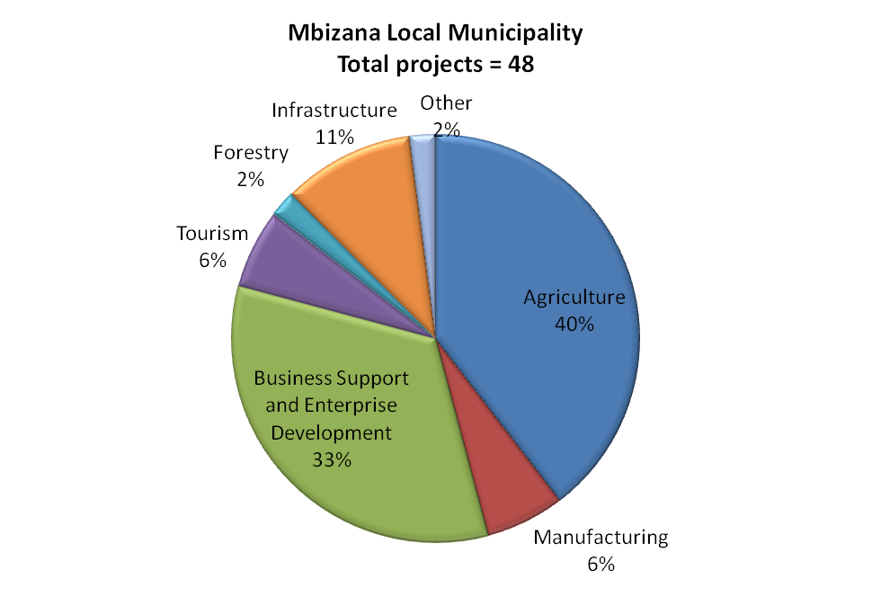
Project distribution per sector and municipality
Mbizana – strong emphasis on agriculture sector
Matatiele – emphasis on infrastructure & business
Matatiele -18 LED projects
  Fewest in district
Infrastructure & business support sectors -28% each
Agricultural, forestry, tourism & manufacturing - 11%
Mbizana-48 LED projects
Largest number of projects in district
Agricultural sector -40%
business support sector -33%
Infrastructure projects -11%

Slide 27
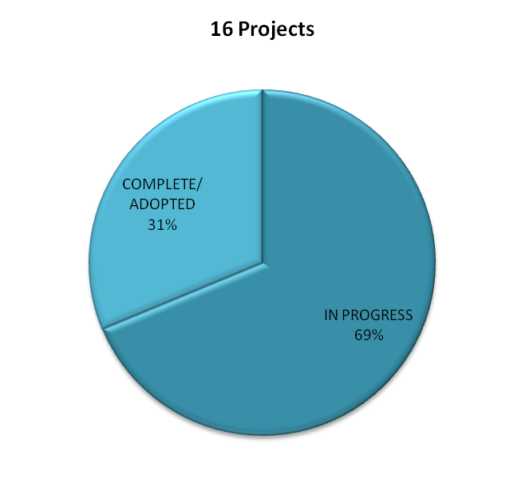
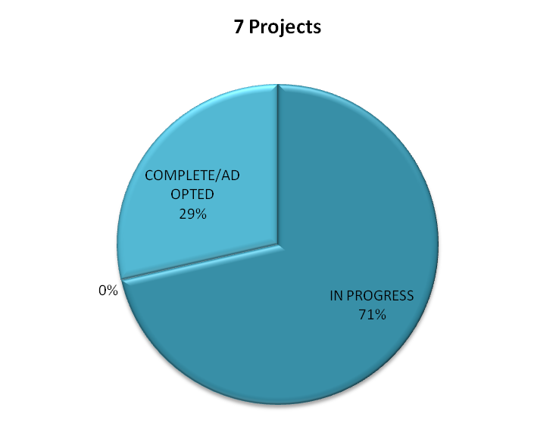
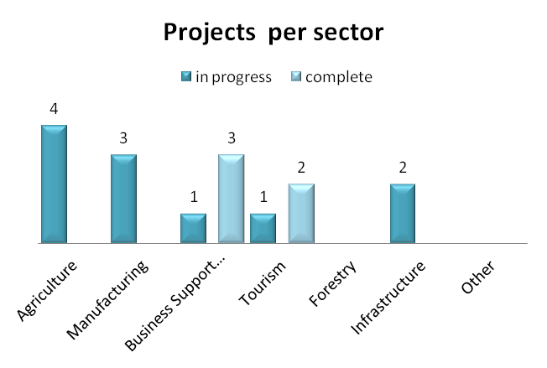
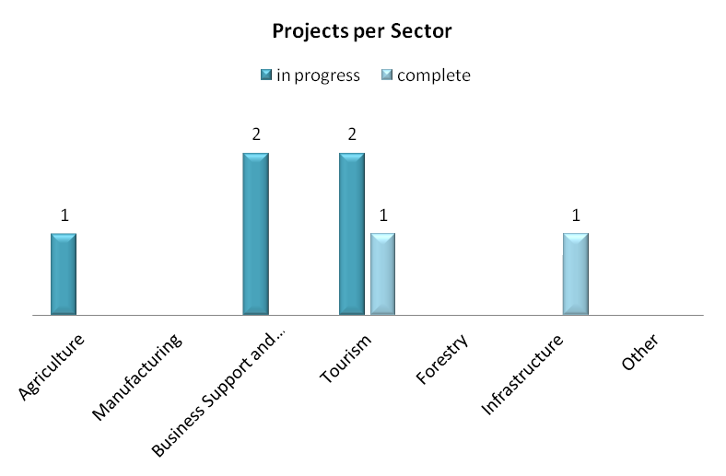
PROJECT STATUS
Umzimvubu -16/30 (53%) are either complete or ongoing
  31% completed
  69% - ongoing
Ntabankulu – 7/34 (20%) are either complete or ongoing
  29% -completed
  71% -ongoing

Slide 28
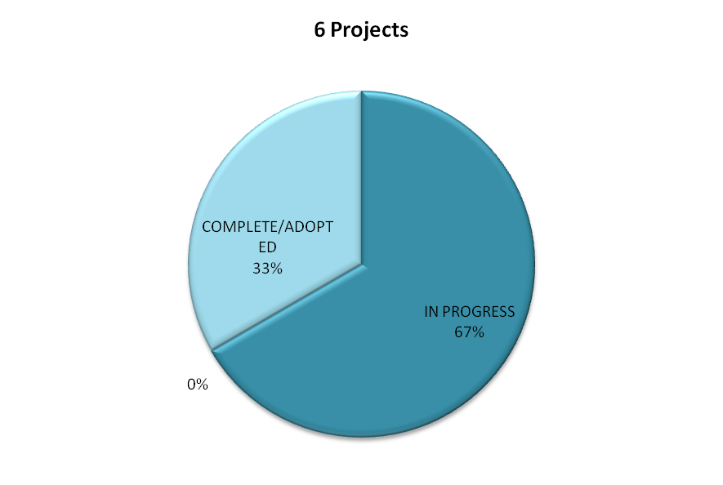
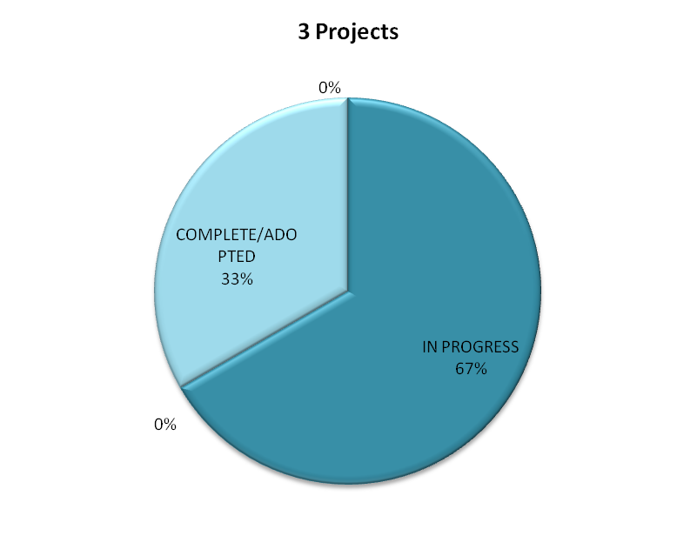
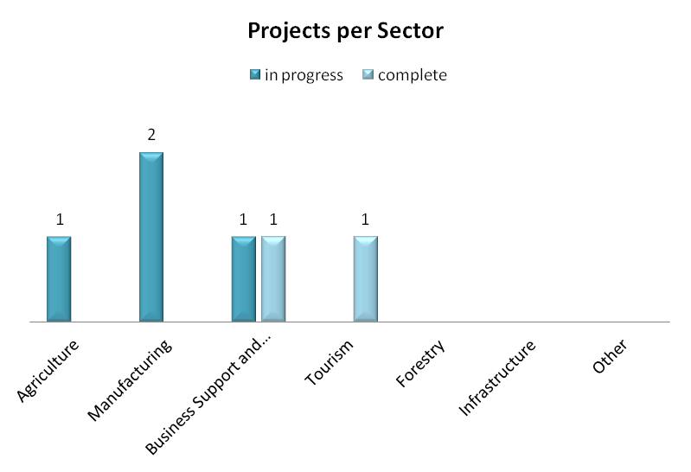
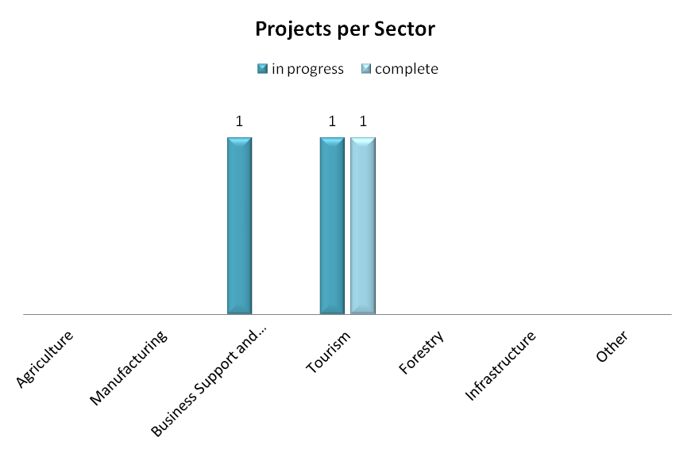
PROJECT STATUS
Matatiele- 6/18(33%) are either complete or ongoing
  33% completed
  67% - ongoing
Mbizana – 3/48(6%) are either complete or ongoing
  33% completed
  67% - ongoing

Slide 29
ACTUAL PERFORMANCE OF ANDM
Perceptions that need to be addressed include:
  Many small low impact initiatives with low momentum for change.
  Traditional approach to LED, which focuses on poverty alleviation through the implementation of small projects.
Structural problems with LED in the District:
  LED Policy is non-existent and should address 1) the utilisation of budgets for leveraging from government; parastatals; private sector (CSI); donor agencies and other development agencies; 2) Allocation of human resources towards LED planning; leveraging of resources and implementation; 3) Prioritization of projects; 4) LED approach over the short, medium and long term.
  Current approach is highly unsustainable in terms of spreading effort with low impact initiatives.
  Low leverage of funding and alignment with government in general.

Slide 30
STRUCTURAL ISSUES
Strategic focus area | Key issue
Job creation | Less than 1 job per household throughout the district
Skills development | Low presence of highly skilled individuals and entrepreneurship
Income generation | Low sectoral diversity and high dependency on few sectors
Cost of living | High cost of living relative to low disposable incomes
Investment | Low investment in primary and secondary sectors
Wages | High dependency on low wage employment sectors
Households | High dependency on few people
Poverty | High incidence of poverty

Slide 31
KEY SECTOR ISSUES
Low economic base
Niche economy – skewed to few sector based on need to provide government support and absorb incomes of low income groups
Government is highest value adder to local economy in terms of budget spend
Government and Community services highest employer followed by Wholesale trade and Agriculture

Slide 32
SPATIAL ISSUES
Peripheral economy;
Dispersed settlement patterns and commercial farming;
Majority land ownership in traditional authority;
Lack of services / backlogs;
Low investment in nodes and corridors;
Tourism and agrarian spatial bias.

Slide 33
LED STRATEGY
ROLE OF ALFRED NZO IN LED
Creating and strengthening multiple social and economic networks that support LED
Developing and maintaining governance systems
Marketing and investment promotion
Infrastructure development and maintenance
Promoting environmentally sustainable development

Slide 34
LED DRIVERS
Local people
Local assets
Main economic sectors
Strategic leadership
Networks and partnerships
Co-operative competition

Slide 35
strategic focus
ANDM LED Strategy - refinement of municipal strategic intent outlined in the IDP and should:
  facilitate and promote synergies
  acknowledges and seeks to refine the development vision outlined in the IDP
  outlines the local economic development goals/objectives
  presents the strategic intervention areas/initiatives
  Acknowledge that the responsibility of the municipality is to create a climate conducive for investment and growth

Slide 36
Development vision
A self-sustainable municipality that guarantees effective and efficient rural development.
ANDM: IDP vision
Economic growth
Community resilience and self-reliance
Service excellence and sustainability
Common purpose
Municipal strategic goals
ECONOMIC DEVELOPMENT OBJECTIVES
To facilitate regional economic economy and create employment opportunities directly and indirectly.
To alleviate poverty and promote socio-economic development.
To create opportunities for youth and women empowerment.
To support SMMEs and create opportunities for growth.
To provide direct strategic support to key economic sectors while promoting new economic sectors.
To facilitate rural development.
To address infrastructure backlogs and unlock latent economic development opportunities.

Slide 37
Development Strategies
Strategy 1: Optimal use of resources the Municipality and other government agencies have access to and controls.
Strategy 2: Facilitating the implementing bulk infrastructure projects unlock economic development potential and opportunities.
Strategy 3: Providing strategic support to key economic sectors.
Strategy 4: Establishing planning frameworks and governance systems that support Local Economic Development.
Strategy 5: Developing and supporting SMME.
1. Mobilisation and Optimal Use of Public Resources
4. LED Governance and Regulation
3. Strategic Support to Key Economic Sectors
5. SMME Development & support
2. Infrastructure Development

Slide 38
LOCAL ECONOMIC DEVELOPMENT PROGRAMS
Mobilisation and Optimal use of Public Resources
INFRASTRUCTURE DEVELOPMENT
Strategic Support to Key Economic Sectors
LOCAL ECONOMIC GOVERNANCE
SMME DEVELOPMENT AND SUPPORT

Slide 39
LOCAL ECONOMIC DEVELOPMENT PROGRAMS
Mobilisation and Optimal use of Public Resources
Public land and buildings release program
  Land audit to identify determine availability and suitability of land for development
  Identification and assessment of vacant and underutilised district municipality and state owned buildings
  Land release at local municipal level for development
Mobilisation of funding
  LED Directorate must lobby and advocate for LED with other departments in the district, provincial and national government

Slide 40
LOCAL ECONOMIC DEVELOPMENT PROGRAMS
INFRASTRUCTURE DEVELOPMENT
Availability and capacity of infrastructure is one of the key factors that influence economic development
Key infrastructure requirements for the promotion of economic development and private sector investment in the area:
  Water and sanitation
  Roads and transportation infrastructure.
  Electricity

Slide 41
LOCAL ECONOMIC DEVELOPMENT PROGRAMS
Support to government services
  High impact public facilities should be focused on the primary node (Mount Ayliff)
Agricultural development
  Common focus areas for the development of this sector and the coordination among role-players are critical for the future development of this sector
  Improve access to agricultural resources
  Create enabling environment for agricultural development
Trade and commerce
  Small town rehabilitation and revitalisation programmes
  Creation of an environment conducive for investment
Tourism development
  Tourism development should focus on tourism corridor, Product development, Supporting infrastructure, Industry regulations, etc.
Strategic Support to Key Economic Sectors

Slide 42
LOCAL ECONOMIC DEVELOPMENT PROGRAMS
Improving public and private sector confidence in the ability of the municipality to administer public affairs and govern effectively and efficiently is a critical step in attracting investment and building loyalty to the area:
By– laws and regulations
  Preparation of effective by-laws and other regulations that affect business performance.
Forward planning
  municipal spatial development vision, in respect of economic development initiatives
Rural settlement plans
Supply chain management
  seeks to promote and support local business in respect of the supply of a range of goods and services.
LED mainstreaming and budgets
Coordinating government led spending
Capacity building -councilors and administration
LOCAL ECONOMIC GOVERNANCE

Slide 43
LOCAL ECONOMIC DEVELOPMENT PROGRAMS
Small Medium Micro Enterprises (SMMEs) represent an important component of the economy of ANDM and plays a major role in the job creation, economic growth and poverty alleviation:
Informal sector advancement programme
  Informal trading policy
  Informal trading management program
SMME infrastructure
  SMME trading centre (incubators), market stalls, market area
Business support program
  Procurement of services and goods from local smmes
  Business retention and expansion program
Cooperatives
  Municipality need to develop and sustain a supportive environment that allows autonomous co-operatives to grow
SMME DEVELOPMENT AND SUPPORT

Slide 44
THANK YOU

